Slide 1
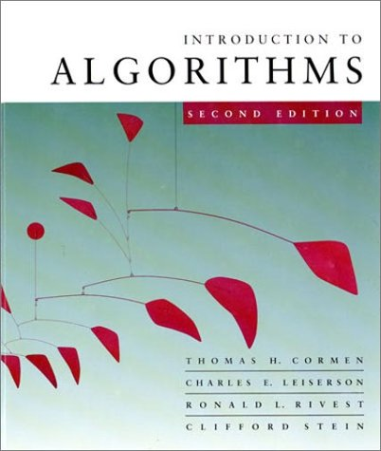
Design and Analysis of Algorithms CSE 373
L1.1
Lecture 1
Dr. Sifat Momen

Slide 2
What is an Algorithm?
An algorithm is a finite set of precise instructions for performing a computation or for solving a problem.
It must produce correct result
It must finish in some finite time
You can represent an algorithm using pseudocode, flowchart, or even actual code
L1.2

Slide 3
Algorithm
Algorithm
input
(optional)
output
Computational procedure for solving a problem

Slide 4
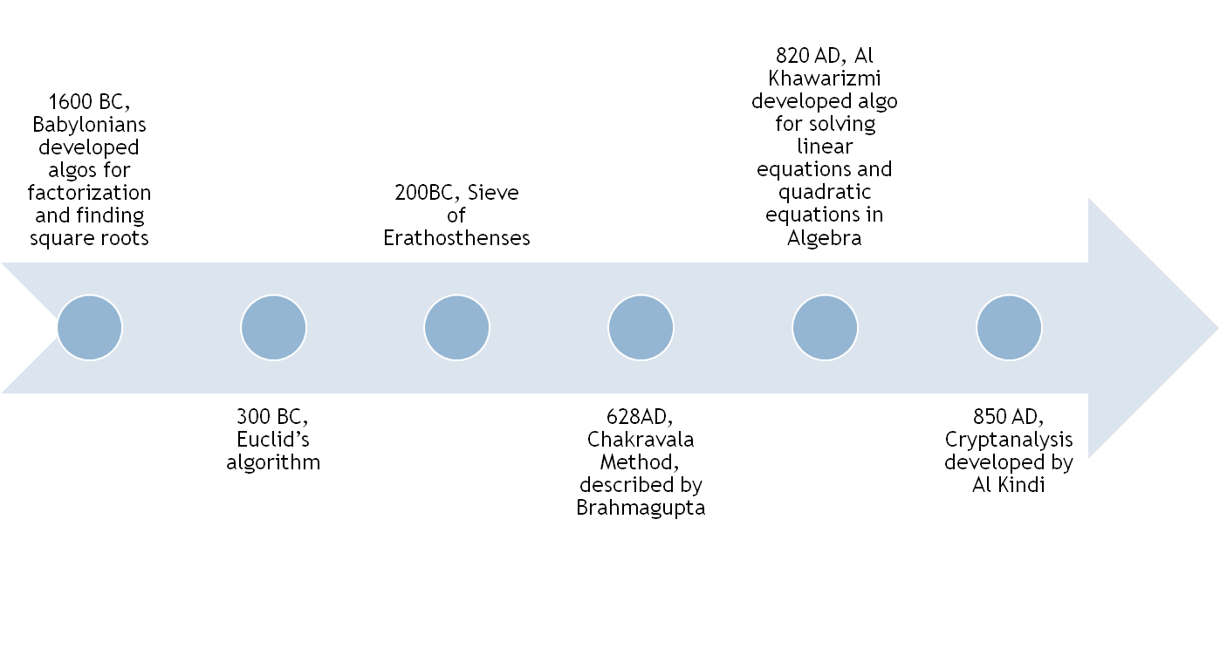
Algorithm (Brief timeline: old)

Slide 5
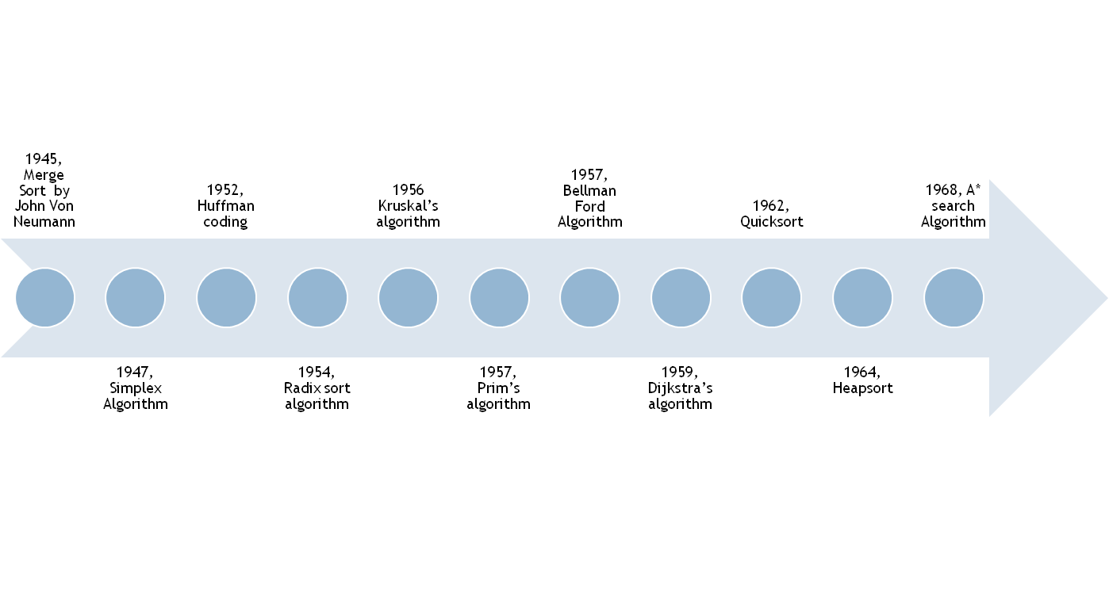
Algorithm(Brief timeline: New Era)

Slide 6
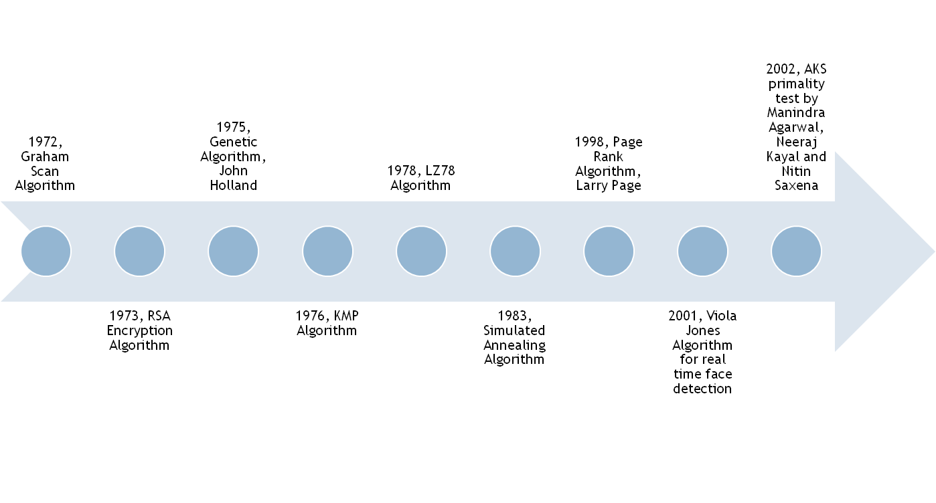
Algorithm(Brief timeline: New Era)

Slide 7
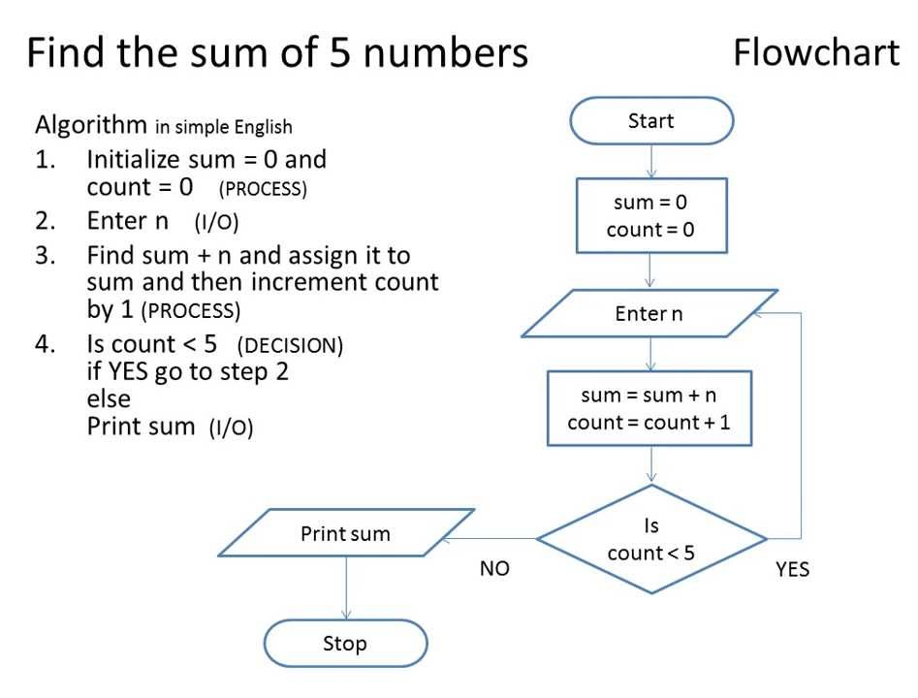
Algorithm Description
L1.7

Slide 8
Algorithm challenge 1
Can you come up with an algorithm to compute the GCD (Greatest Common Divisor) of two integers.
L1.8

Slide 9
Algorithm Challenge 2
You are given all numbers between 1,2,…,n except one. Your task is to find the missing number. Input The first input line contains an integer n. The second line contains n−1n−1 numbers. Each number is distinct and between 11 and nn (inclusive). Output Print the missing number. Example Input: 5 2 3 1 5 Output: 4
L1.9

Slide 10
Algorithm Challenge 3
Given a sorted array and an integer value (say sum), design an algorithm that will determine if there exists a pair of integer whose sum is equal to sum.

Slide 11
What is this course about?
The theoretical study of design and analysis of computer algorithms
Basic goals for an algorithm:
always correct
always terminates
performance
Performance often draws the line between
what is possible and what is impossible.
L1.11
Notes:
11

Slide 12
Design and Analysis of Algorithms
Analysis: predict the cost of an algorithm in terms of resources and performance
Design: design algorithms which minimize the cost
L1.12

Slide 13
Why designing and analysis of algorithm is important?
Example:
Imagine two friends, Alice and Bob are given the task of writing an algorithm that can sort 10 million numbers
Alice writes an algorithm that takes 2N² instructions and implements using computer that executes 10 billion instructions per second.
Bob writes an algorithm that takes 50NlgN instructions and implements using computer that executes only 10 million instructions per second.
Which one runs faster?
L1.13

Slide 14
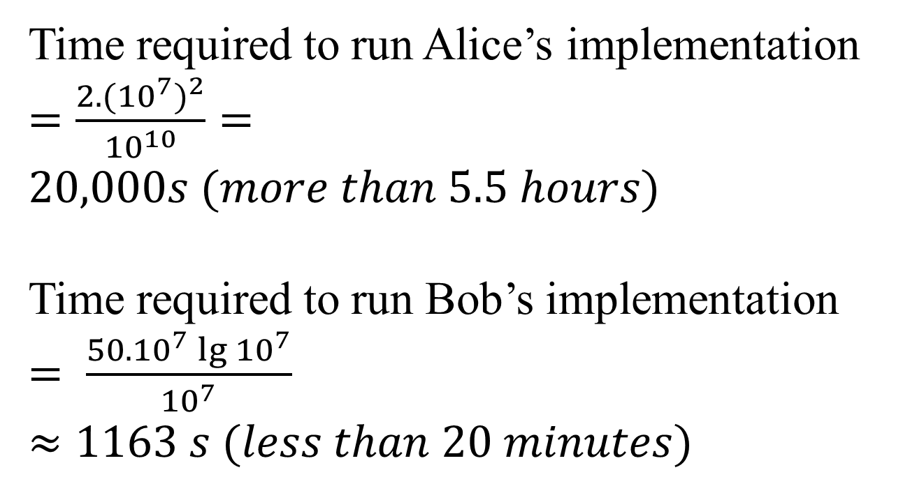
Why designing and analysis of algorithm is important?
L1.14

Slide 15
The Problem of Sorting
Input: sequence 〈a₁, a₂, …, a_{n}〉 of numbers.
Output: permutation 〈a'₁, a'₂, …, a'_{n}〉 such
that a'₁ ≤ a'₂ ≤ … ≤ a'_{n} .
Example:
Input: 8 2 4 9 3 6
Output: 2 3 4 6 8 9
L1.15

Slide 16
Sorting Algorithms
There are various sorting algorithms including bubble sort, insertion sort, quick sort, merge sort, bucket sort, shell sort etc…
Can either be a stable or an unstable sorting algorithm.
A sorting algorithm is said to be stable if two objects with equal keys appear in the same order in sorted output as they appear in the input array to be sorted.
L1.16

Slide 17
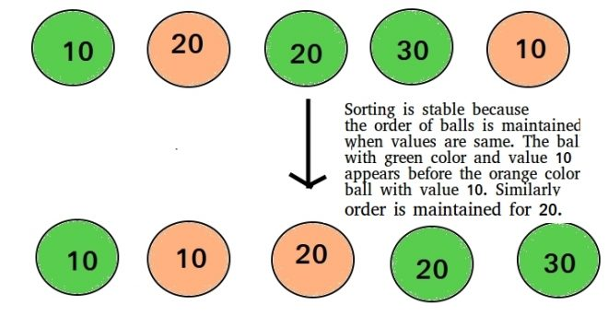
Stability of a sort
L1.17

Slide 18
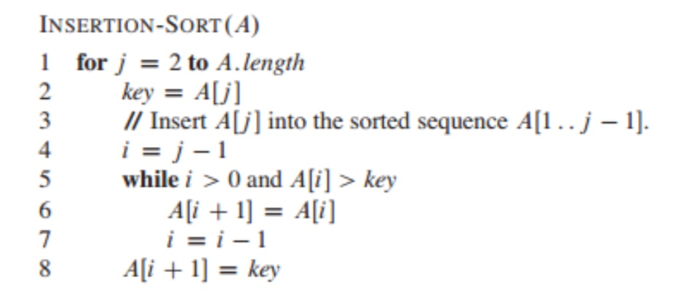
Insertion sort
L1.18

Slide 19
Example of insertion sort
8
2
4
9
3
6
L1.19

Slide 20
Example of insertion sort
8
2
4
9
3
6
L1.20

Slide 21
Example of insertion sort
8
2
4
9
3
6
2
8
4
9
3
6
L1.21

Slide 22
Example of insertion sort
8
2
4
9
3
6
2
8
4
9
3
6
L1.22

Slide 23
Example of insertion sort
8
2
4
9
3
6
2
8
4
9
3
6
2
4
8
9
3
6
L1.23

Slide 24
Example of insertion sort
8
2
4
9
3
6
2
8
4
9
3
6
2
4
8
9
3
6
L1.24

Slide 25
Example of insertion sort
8
2
4
9
3
6
2
8
4
9
3
6
2
4
8
9
3
6
2
4
8
9
3
6
L1.25

Slide 26
Example of insertion sort
8
2
4
9
3
6
2
8
4
9
3
6
2
4
8
9
3
6
2
4
8
9
3
6
L1.26

Slide 27
Example of insertion sort
8
2
4
9
3
6
2
8
4
9
3
6
2
4
8
9
3
6
2
4
8
9
3
6
2
3
4
8
9
6
L1.27

Slide 28
Example of insertion sort
8
2
4
9
3
6
2
8
4
9
3
6
2
4
8
9
3
6
2
4
8
9
3
6
2
3
4
8
9
6
L1.28

Slide 29
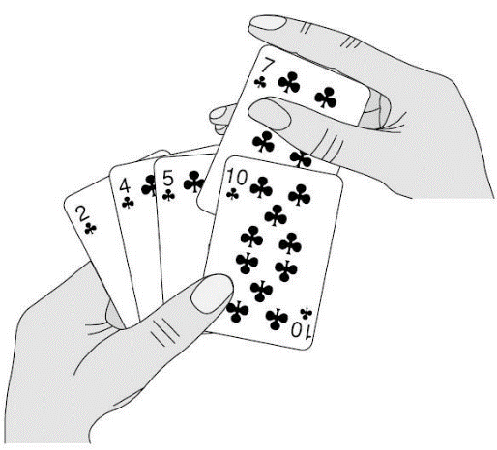
Example of insertion sort
8
2
4
9
3
6
2
8
4
9
3
6
2
4
8
9
3
6
2
4
8
9
3
6
2
3
4
8
9
6
2
3
4
6
8
9
done
L1.29

Slide 30
C++ Implementation of Insertion Sort
int main(){
int arr[] = {10, 6, 3, 2, 1, 8};
int l = sizeof(arr)/sizeof(*arr);
print(arr, l);
insertionSort(arr, l);
print(arr, l);
}
L1.30

Slide 31
C++ Implementation of Insertion Sort
void insertionSort(int A[], int length){
int key, i;
for(int j = 1; j < length; j++){
key = A[j];
i = j - 1;
while(i > -1 && A[i] > key){
A[i+1] = A[i];
i = i - 1;
}
A[i+1] = key;
}
}
L1.31

Slide 32
Print Function
void print(int a[], int length){
for(int i = 0; i < length; i++)
cout << a[i] <<" ";
cout <<endl;
}
L1.32

Slide 33
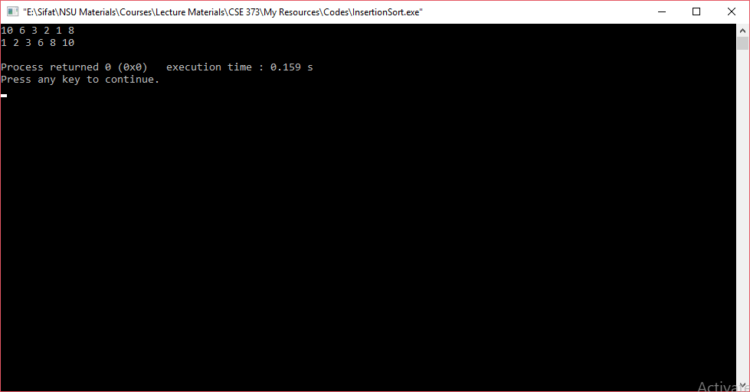
Output
L1.33

Slide 34
Running time
The running time depends on the input: an already sorted sequence is easier to sort.
Major Simplifying Convention: Parameterize the running time by the size of the input, since short sequences are easier to sort than long ones.
T_{A}(n) = time of A on length n inputs
Generally, we seek upper bounds on the running time, to have a guarantee of performance.
L1.34

Slide 35
Kinds of analyses
Worst-case: (usually)
T(n) = maximum time of algorithm on any input of size n.
Average-case: (sometimes)
T(n) = expected time of algorithm over all inputs of size n.
Need assumption of statistical distribution of inputs.
Best-case: (NEVER)
Cheat with a slow algorithm that works fast on some input.
L1.35

Slide 36
Insertion Sort
INSERTION-SORT (A, n) ⊳ A[1 . . n]
for j ← 2 to n
do key ← A[ j]
i ← j – 1
while i > 0 and A[i] > key
do A[i+1] ← A[i]
i ← i – 1
A[i+1] = key
What is the estimated running time?
Depends on arrangement of numbers in the input array. We are typically interested in the runtime of an algorithm in the worst case scenario.
Because it provides us a guarantee that the algorithm won’t take any longer than this for any type of input.
How can you arrange the input numbers so that this algorithm becomes most inefficient (worst case)?
36

Slide 37
Analyzing Algorithms
Analyzing an algorithm means predicting the resources that the algorithm requires.
Typically time and memory
Before we can analyze an algorithm, we need a model of implementation technologies that we will use.
Random Access Machine Model
37

Slide 38
Random Access Machine model
Single Processor
Instructions are executed one after another, with no concurrent operations
The following instructions take a constant amount of time
Arithmetic: add, subtract, multiply, divide, remainder, floor, ceiling etc…
Data movement: load, store, copy
Control: conditional/unconditional branch, subroutine call, return
Data type: Integer and Float
38

Slide 39
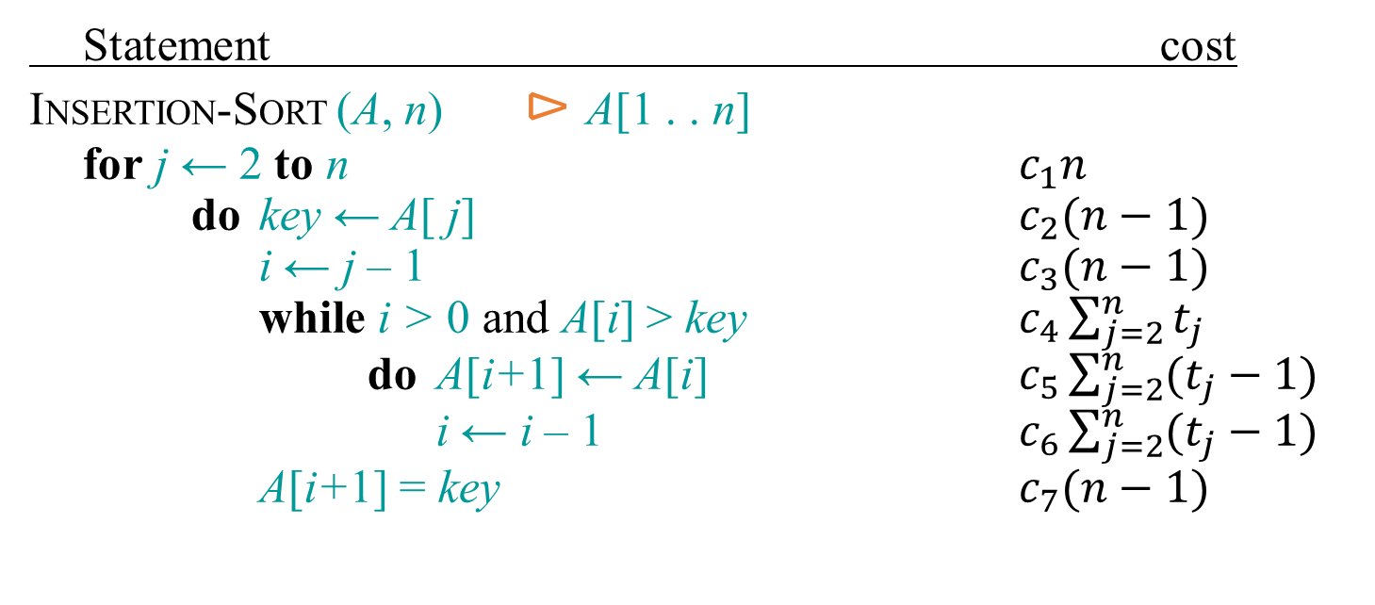
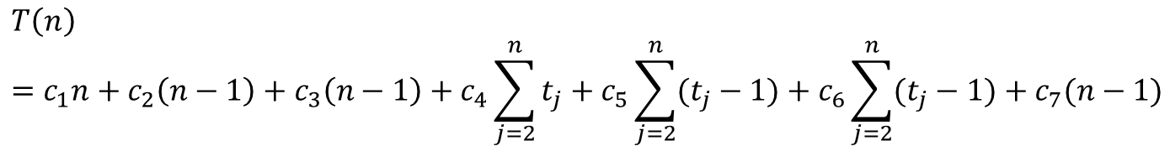
Insertion Sort: Running Time
Here t_{j} = no. of times the condition of while loop is tested for the current value of j.
In the worst case (when input is reverse-sorted), in each iteration of the for loop, all the j-1 elements need to be right shifted and the key will be inserted in the front of them, i.e., t_{j}=j. Using this in the above equation, we get: T(n) = An²+Bn+C, where A, B, C are constants.
39
What is T(n) in the best case (when the input numbers are already sorted)?

Slide 40
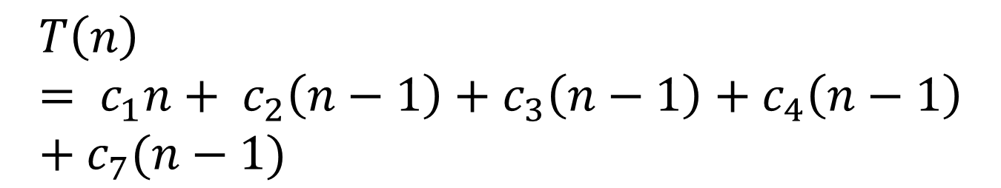
Insertion Sort: Running Time (Best case)
The best case is when the input is already in the sorted manner.
Thus t_{j} = 1
This can be expressed as T(n) = an + b, thus T(n) = O(n)
40

Slide 41
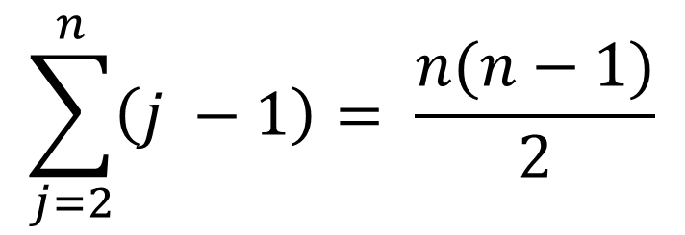
Insertion Sort: Running Time (Worst case)
The worst case results when the array is in the reverse order (in this case decreasing order)
In this situation, we must compare each element A[j] with each element in the entire sorted sub-array A[1… j-1]
This results t_{j} = j
L1.41

Slide 42
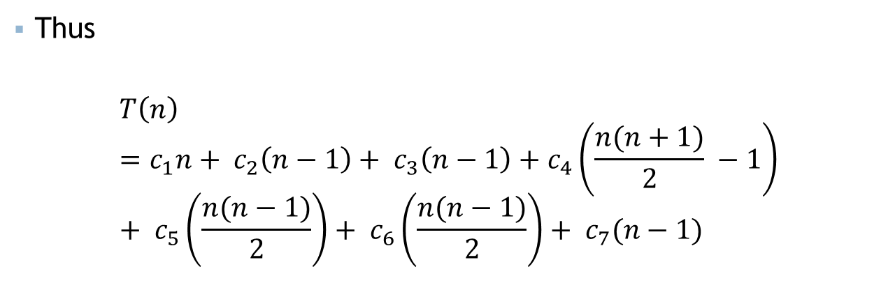
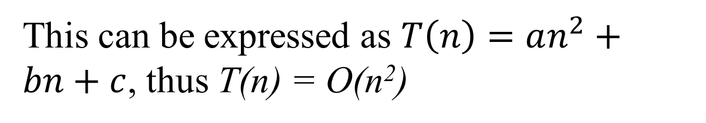
Insertion Sort: Running Time (Worst case)
L1.42

Slide 43
Asymptotic Analysis
To compare two algorithms with running times f(n) and g(n), we need a rough measure that characterizes how fast each function grows.
Hint: use rate of growth
Compare functions in the limit, that is, asymptotically!
(i.e., for large values of n)

Slide 44
Rate of Growth
Consider the example of buying elephants and goldfish:
Cost: cost_of_elephants + cost_of_goldfish
Cost ~ cost_of_elephants (approximation)
The low order terms, as well as constants in a function are relatively insignificant for large n
6n + 4 ~ n
n⁴ + 100n² + 10n + 50 ~ n⁴
i.e., we say that n⁴ + 100n² + 10n + 50 and n⁴ have the same rate of growth

Slide 45
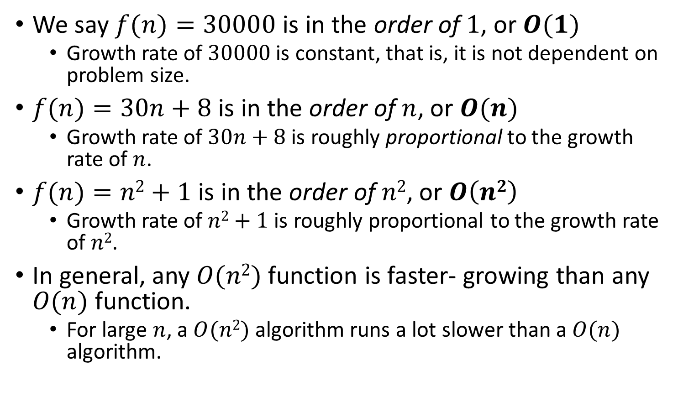
Big-O Notation

Slide 46
Visualizing Orders of Growth
On a graph, as you go to the right, a faster growing function eventually becomes larger.
f_{A}(n)=30n+8
Running time→
f_{B}(n)=n²+1
Increasing n →

Slide 47
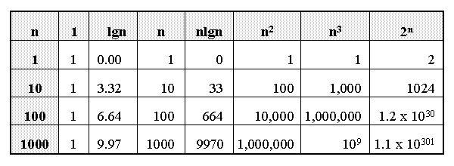
Growth of Functions

Slide 48
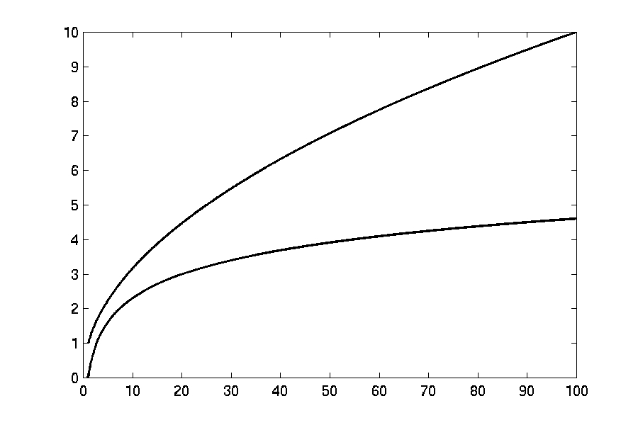
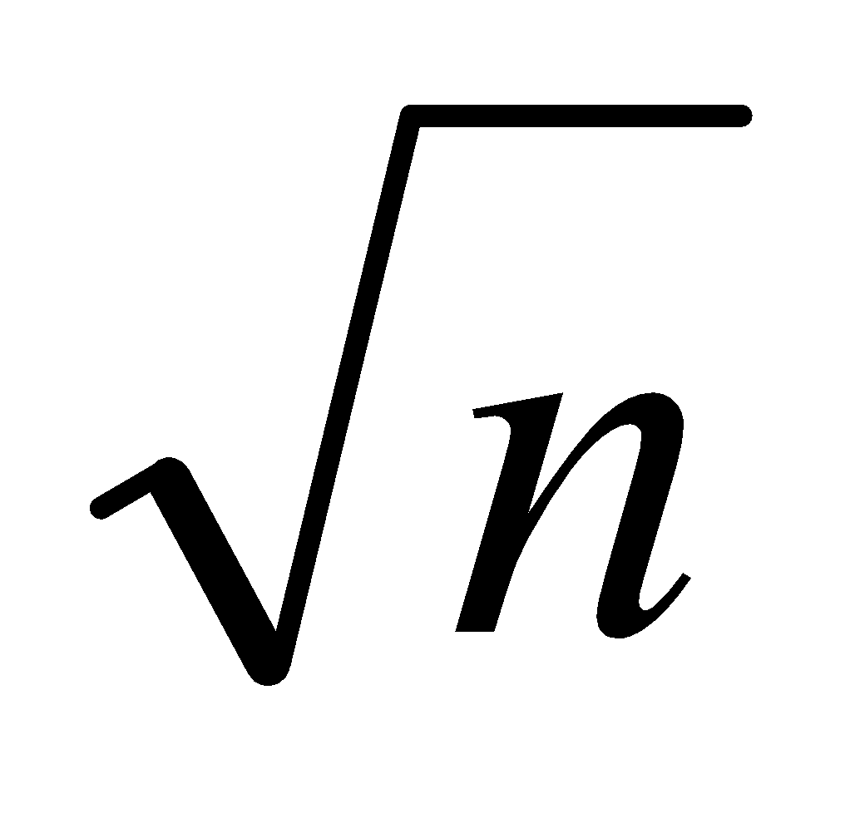
Complexity Graphs
log(n)

Slide 49
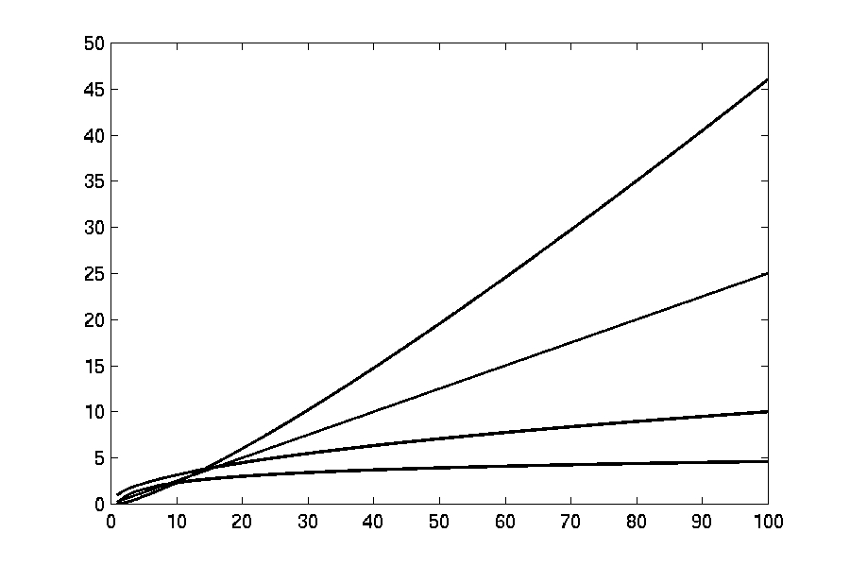
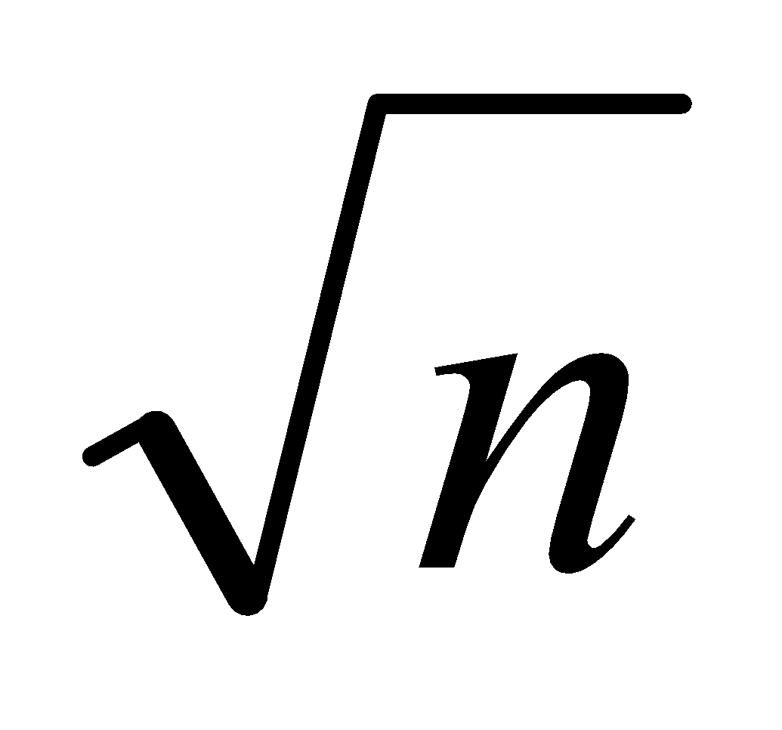
Complexity Graphs
n log(n)
n
log(n)

Slide 50
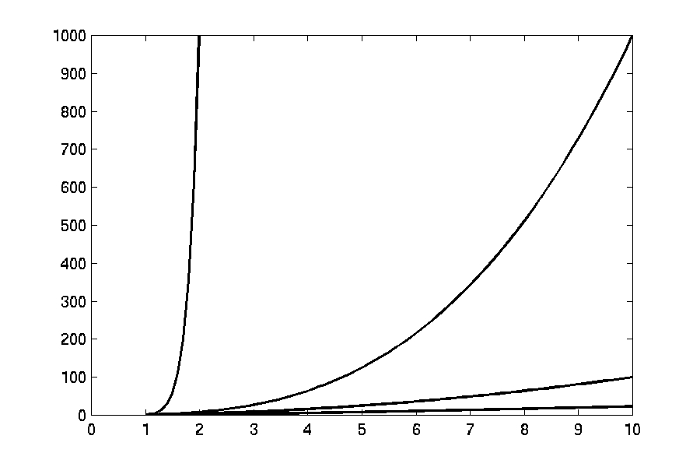
Complexity Graphs
n¹⁰
n³
n²
n log(n)

Slide 51
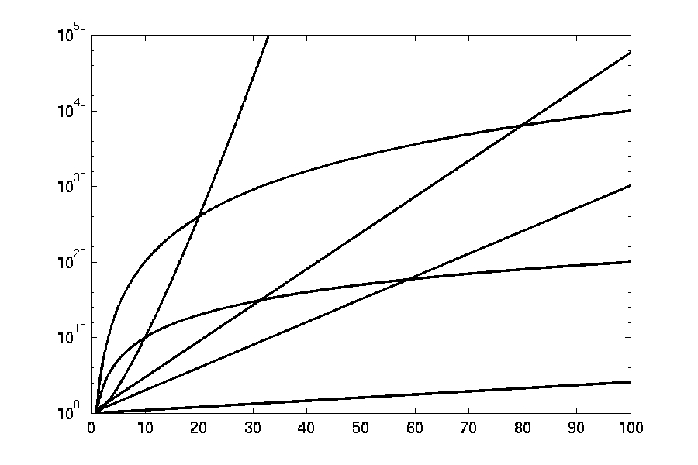
Complexity Graphs (log scale)
3^{n}
n^{n}
n²⁰
2^{n}
n¹⁰
1.1^{n}

Slide 52
Asymptotic Notations
O notation: asymptotic “upper bound”:
Ω notation: asymptotic “lower bound”:
Θ notation: asymptotic “tight bound”:

Slide 53
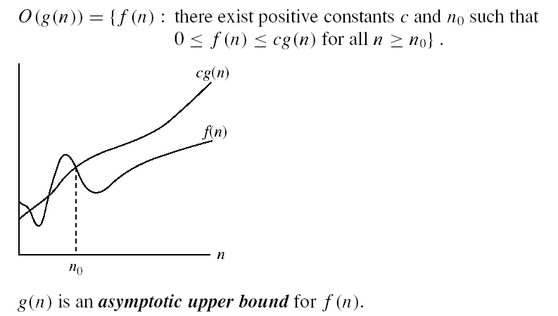
Asymptotic Notations
O-notation
O(g(n)) is the set of functions with smaller or same order of growth as g(n)
Examples:
T(n) = 3n²+10nlgn+8 is O(n²), O(n²lgn), O(n³), O(n⁴), …
T’(n) = 52n²+3n²lgn+8 is O(n²lgn), O(n³), O(n⁴), …

Slide 54
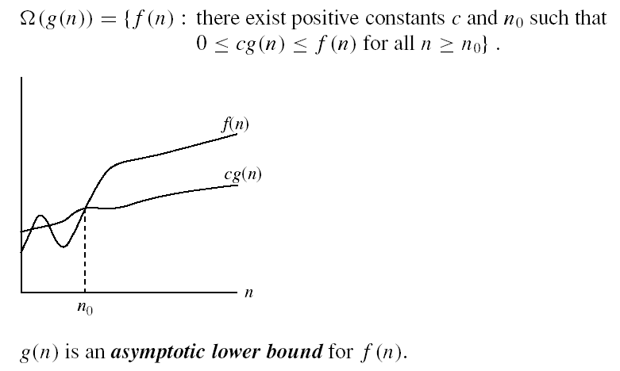
Asymptotic Notations
Ω - notation
Ω(g(n)) is the set of functions with larger or same order of growth as g(n)
Examples:
T(n)=3n²+10nlgn+8 is Ω(n²), Ω(nlgn), Ω(n), Ω(nlgn),Ω(1)
T’(n) = 52n²+3n²lgn+8 is Ω(n²lgn), Ω(n²), Ω(n), …

Slide 55

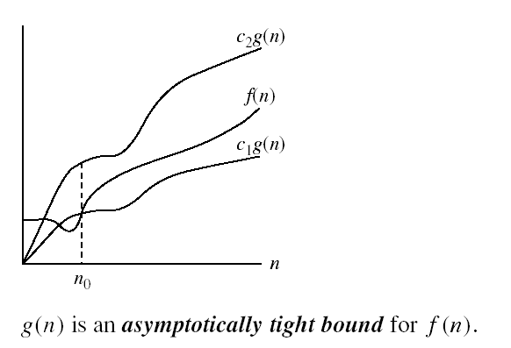
Asymptotic Notations
Θ-notation
Θ(g(n)) is the set of functions with the same order of growth as g(n)
* f(n) is both O(g(n)) & Ω(g(n)) ↔ f(n) is Θ(g(n))
Examples:
T(n) = 3n²+10nlgn+8 is Θ(n²)
T’(n) = 52n²+3n²lgn+8 is Θ(n²lgn)

Slide 56
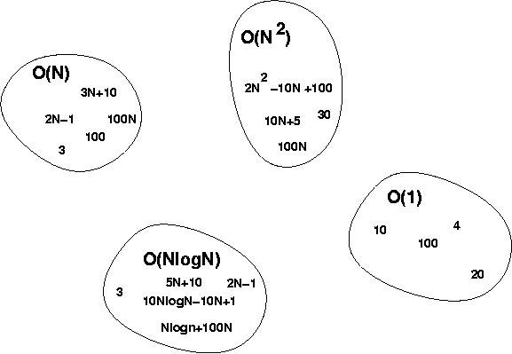
Big-O Visualization

Slide 57
Some Examples
Determine the time complexity for the following algorithm.
count = 0;
for(i=0; i<10000; i++)
count++;

Slide 58

Some Examples
Determine the time complexity for the following algorithm.
count = 0;
for(i=0; i<10000; i++)
count++;

Slide 59
Some Examples
Determine the time complexity for the following algorithm.
count = 0;
for(i=0; i<n; i++)
count++;

Slide 60

Some Examples
Determine the time complexity for the following algorithm.
count = 0;
for(i=0; i<n; i++)
count++;

Slide 61
Some Examples
Determine the time complexity for the following algorithm.
sum = 0;
for(i=0; i<n; i++)
for(j=0; j<n; j++)
sum += arr[i][j];

Slide 62
Some Examples
Determine the time complexity for the following algorithm.
sum = 0;
for(i=0; i<n; i++)
for(j=0; j<n; j++)
sum += arr[i][j];
O(n²)

Slide 63
Some Examples
Determine the time complexity for the following algorithm.
count = 0;
for(i=1; i<=n; i=i*2)
count++;

Slide 64
Some Examples
Determine the time complexity for the following algorithm.
count = 0;
for(i=1; i<=n; i=i*2)
count++;
O(lg n)

Slide 65
Some Examples
Determine the time complexity for the following algorithm.
sum = 0;
for(i=1; i<n; i=i*2)
for(j=0; j<n; j++)
sum += i*j;

Slide 66
Some Examples
O(n lg n)
Determine the time complexity for the following algorithm.
sum = 0;
for(i=1; i<n; i=i*2)
for(j=0; j<n; j++)
sum += i*j;

Slide 67
Some Examples
Determine the time complexity for the following algorithm.
sum = 0;
for(i=1; i<=n; i=i*4)
for(j=0; j<=n; j*=2)
sum += i*j;
Asympotic Tight Bound: Θ(lg n)
WHY?

Slide 68
Some Examples
Determine the time complexity for the following algorithm.
sum = 0;
for(i=1; i<n; i=i*2)
for(j=0; j<i; j++)
sum += i*j;

Slide 69
Some Examples
Determine the time complexity for the following algorithm.
sum = 0;
for(i=1; i<n; i=i*2)
for(j=0; j<i; j++)
sum += i*j;
Loose Upper Bound: O(n lg n)
Tight Upper Bound: O(n)
Asympotic Tight Bound: Θ(n)
WHY?

Slide 70
Some Examples
Determine the time complexity for the following algorithm.
char someString[10];
gets(someString);
for(i=0; i<strlen(someString); i++)
someString[i] -= 32;

Slide 71

Some Examples
Determine the time complexity for the following algorithm.
char someString[10];
gets(someString);
for(i=0; i<strlen(someString); i++)
someString[i] -= 32;

Slide 72
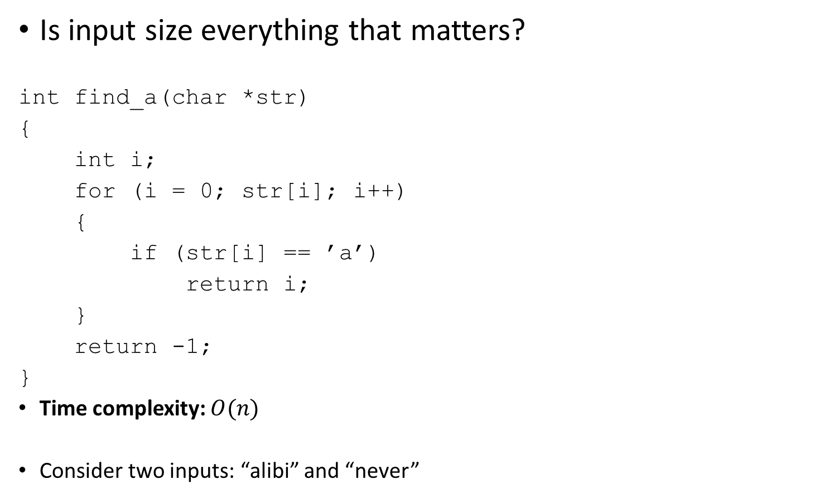
Types of Analysis

